Slide 1
Evaluation Metric For Machine Learning

Slide 2
Evaluation Metric for ML
Supervised Learning
Classification
Regression
Un-supervised Learning

Slide 3
Evaluation Metric For Supervised Learning

Slide 4
Classification Task
Classifier gives probability of each class
Based on threshold classifier decides the output label
Threshold is always between 0 to 1
Ex.
Not a Cancer or Cancer → probabilities = [0.9,0.1]
Outputs need to be evaluated to improve the performance of the classifier
NOTE: Sometimes threshold is also known as operating point

Slide 5
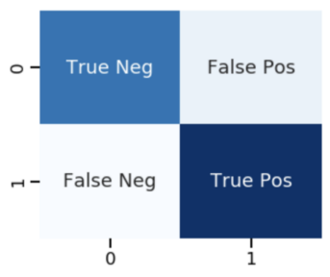
Classification Algorithm Evaluation
Confusion Matrix
Ref: https://scikit-learn.org/stable/modules/generated/sklearn.metrics.confusion_matrix.html
X Axis – Predicted labels / values
Y Axis – Actual labels / values

Slide 6
Confusion matrix Example ( Binary Classification)
Y_actual = [ 0 , 0 , 0, 0, 1, 1, 1 ,1]
Y_predicted = [ 1, 0 , 0, 0, 0, 1, 0, 1]
True Positive : Y_actual == 1 and Y_predict ==1 :: ??
True Negative : Y_actual == 0 and Y_predict ==0 :: ??
False Positive : Y_actual == 0 and Y_predict ==1 :: ??
False Negative : Y_actual == 1 and Y_predict ==0 :: ??

Slide 7
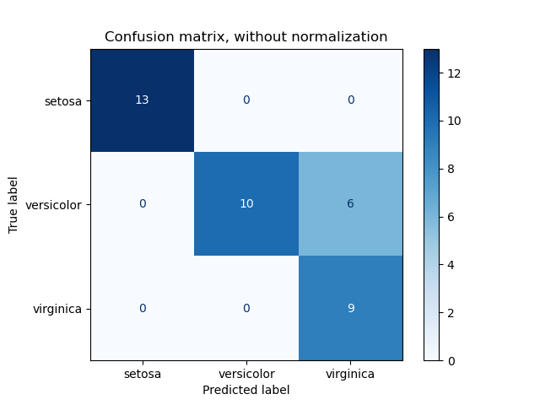
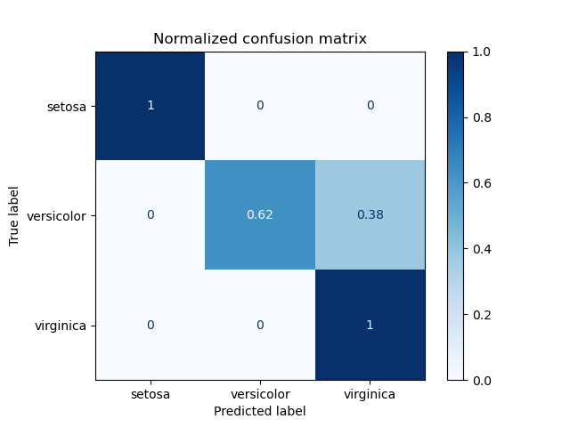
Confusion matrix Example ( Multi Class-Classification)
Normalized confusion matrix provides better understanding in Multi-class Classification
which classes are detected
which are not detected
Ref: https://scikit-learn.org/stable/auto_examples/model_selection/plot_confusion_matrix.html

Slide 8
Classification Algorithm Evaluation
Recall = TP / (TP + FN)
Precision = TP / (TP + FP)
F1 Score = 2 * Precision * Recall / (Precision + Recall)
Accuracy = (TP + TN ) / Total Samples

Slide 9
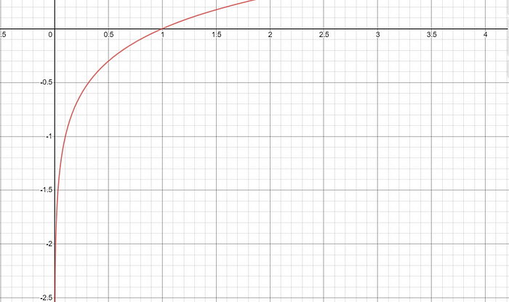
Classification Algorithm Evaluation
Log Loss (Cross-Entropy)
Tells you how confident the model is in assigning a class to an observation.
For any given problem, a lower log-loss value means better predictions.
Log is taken to give
less penalty to less difference
And more penalty when more difference
All values of log loss are negative
min = -inf ( log(0))
max = 0 ( log(1))
Ref: https://scikit-learn.org/stable/modules/model_evaluation.html#log-loss

Slide 10
Classification Algorithm Evaluation
Log Loss (Cross-Entropy)
Average of negative log of corrected probabilities.
All log loss values are negative so, we take negative log
Corrected probability
if y=1 then p
else y=0 then (1-p)
Log loss = - 1/N * sum( yi * log(pi) + (1-yi) * log(1-pi))
Pi = probability of 1
Yi = actual output 0/1.

Slide 11
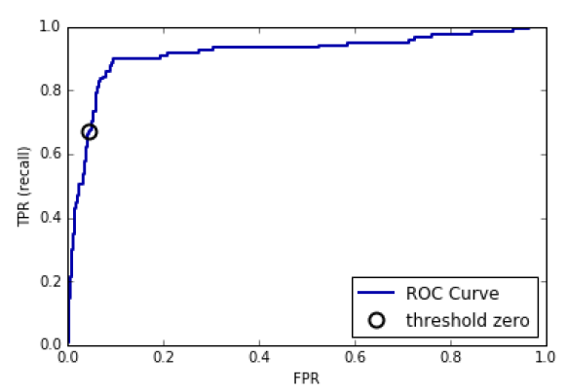
Classification Algorithm Evaluation
ROC (Receiver Operating Characteristic Curve)
Graph of values of true positive rate and false positive rate
TPR and FPR are calculated for various thresholds used by classifier for taking classification decision
AUC (Area Under Curve for ROC Curve)
Area under the ROC curve
ROC and AUC used when
Dataset is balanced

Slide 12
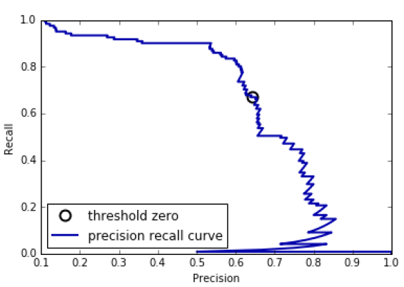
Classification Algorithm Evaluation
Precision Recall Curve
Graph of various precision and recall values for different thresholds
Average Precision Score
Area under the curve of
Precision Recall Curve is known as
average precision score
Usage
Precision Recall Curve and
Average Precision is used when
Dataset is imbalanced

Slide 13
Regression Task
Regressor gives a numeric value
Outputs need to be evaluated to improve the performance of the regressor

Slide 14



Regression Task ( Prediction of Number)
Mean Absolute Error
Root Mean Squared Error
Coefficient of Determination / R-squared (r^2) **
** NOT for time series

Slide 15
Evaluation Metric For Un-Supervised Learning

Slide 16
Clustering Evaluation
Clustering algorithms group the data together
In training there is no label present
They assign the group numbers randomly to the groups
Group number is not fixed , its not like class
So, same algorithms at different times may give different number to same group
So, two different clustering algorithms may give a different number to the same group.
Evaluating clustering is more challenging than supervised learning because no labels in training and group numbers are also not fixed

Slide 17

Evaluation Parameters (Quality Measures: Don’t require Labels)
Silhouette Coefficient
uses:
mean intra-cluster distance for each sample (cohesion)(a)
Mean of distances between samples within the cluster
mean nearest-cluster distance for each sample (separation)(b)
Mean of distance between any sample to nearest cluster
(b-a) / max(a,b)
The best value is 1
the worst value is -1.
Values near 0 indicate overlapping clusters.
Negative values generally indicate wrong cluster for the sample
It shows compactness so, complex shape’s compactness cannot be represented properly
Extra:
Davies-Bouldin score
Calinski and Harabasz score

Slide 18
Extra Un-supervised Learning Evaluation Measures

Slide 19
Evaluation Parameters (Compare two clustering strategies)
Mutual Information
Measures information shared by two clustering algorithms (ex. true clustering and current clustering)
Adjusted Mutual Information (AMI)
MI value adjusted for chance ( means different combinations)
Rand Index ( Based on Mr. Rand )
Measure similarity between two clustering algorithms
Adjusted Rand Index (ARI)
RI value is adjusted for chance ( means different combinations)
Link ARI vs AMI : https://stats.stackexchange.com/questions/260487/adjusted-rand-index-vs-adjusted-mutual-information

Slide 20
Evaluation Parameters (Compare two clustering strategies)
Example:
ClustAlgo1 = [1,1,1,2,2]
ClustAlgo2 = [2,1,2,1,1]
Mutual Information : 1 labels match exactly
Adjusted MI : Adjust the cluster numbers so that max match is possible.
For example, lets switch 1 and 2 in ClustAlgo2 = [1,2,1,2,2]
Now there are 4 labels matching!
Normalized MI: 4/5 = 0.8 match

Slide 21
Evaluation Parameters (Require Labels)
Homogeneity
if all of its clusters contain only data points which are members of a single label from actual data.
Completeness
if all the data points that are members of a given class are elements of the same cluster.
V-measure
harmonic mean between homogeneity and completeness
Can be used for comparing two clustering algorithms

Slide 22
Evaluation Parameters (Require Labels)
Example: there 6 samples
Actual_labels = [1,2,3,4,5,6]
ClusterAlgo1 = [1,2,3,4,5,6]
Low homogeneity and low completeness
ClusterAlgo2 = [1,2,3,4,5,6]
high homogeneity but low completeness bcz data of class 1 split in two clusters
ClusterAlgo3 = [1,2,3,4,5,6]
Completeness is there for class 1 but less for class 2
Homogeneity is very high

